Slide 1
ECSE 428
Complex DC Calculator
< By David Zhou (261135446) and David Vo (261170038) >

Slide 2
Overview
The goal of the project is to implement a simplified version of ‘dc’ that works with both real numbers and complex numbers.
Technology used: Python, pytest
Test-Driven Development
1.Write smallest failing test
2.Write minimum code to pass
3.Run full test suite
4.Refactor if needed

Slide 3
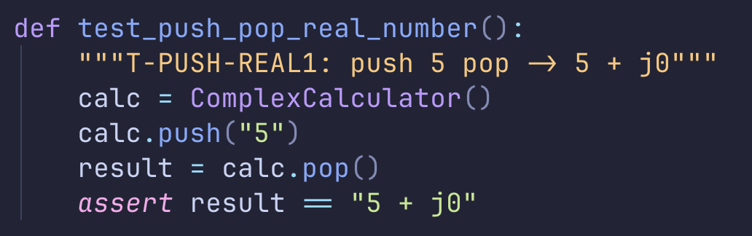
TEST1: T-PUSH-REAL1
Test ID: T-PUSH-REAL1
Operation: PUSH and POP
Command: push 5 pop
Expected Output: 5 + j0

Slide 4
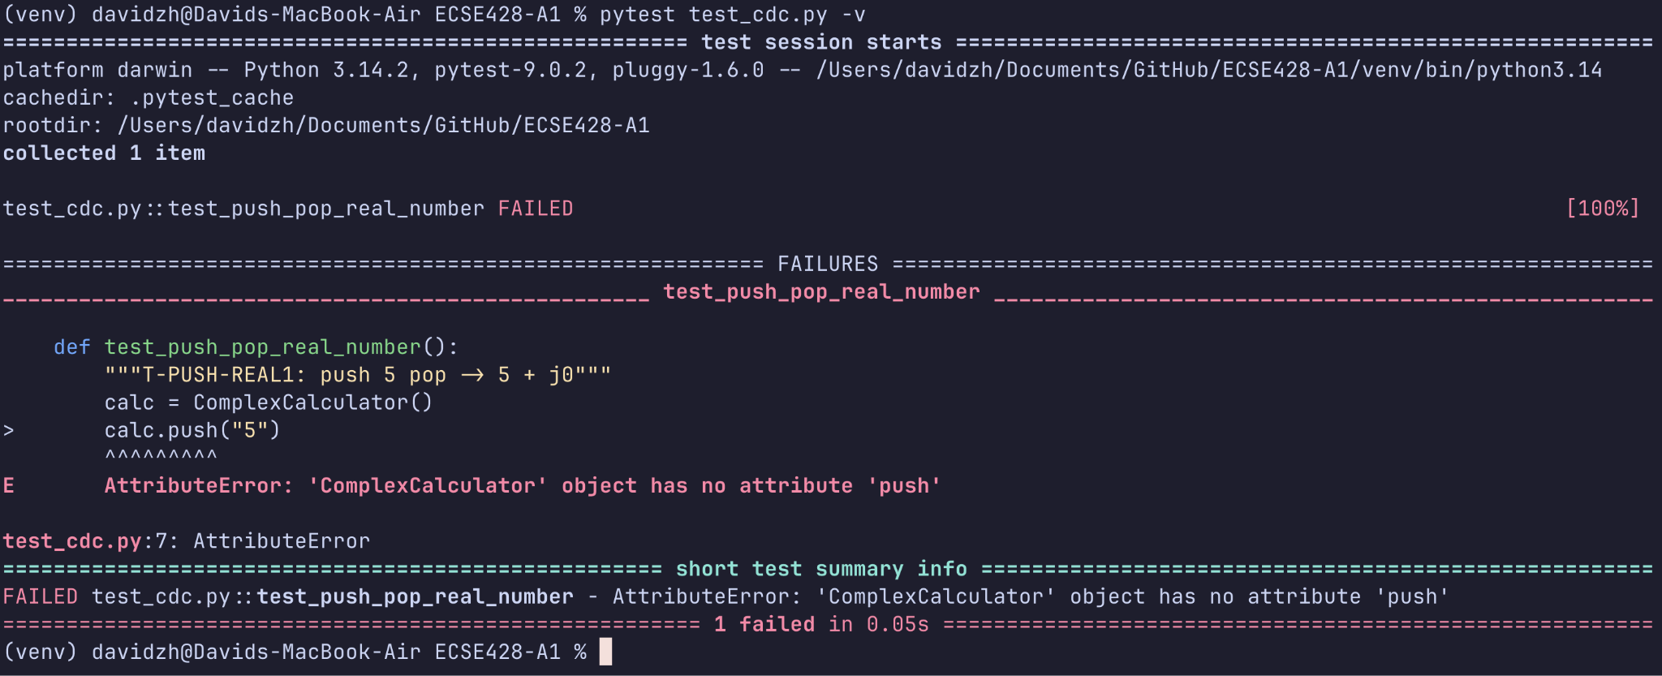
TEST1 FAILURE

Slide 5
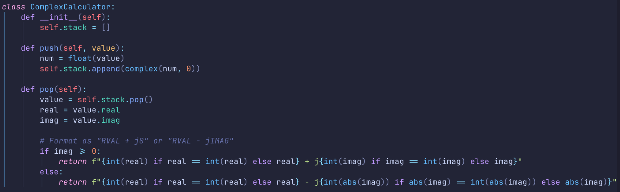
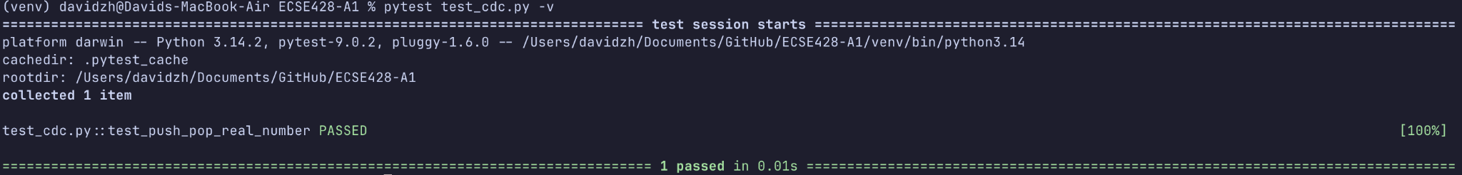
TEST1 SUCCESS

Slide 6
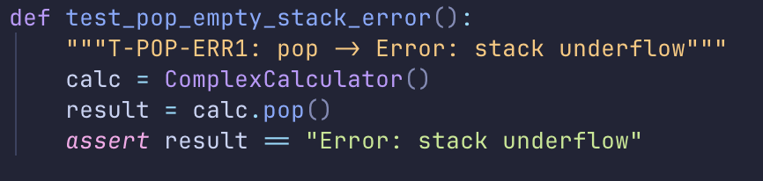
TEST2: T-POP-ERR1
Test ID: T-POP-ERR1
Operation: POP
Command: pop
Expected Output: Error stack underflow

Slide 7
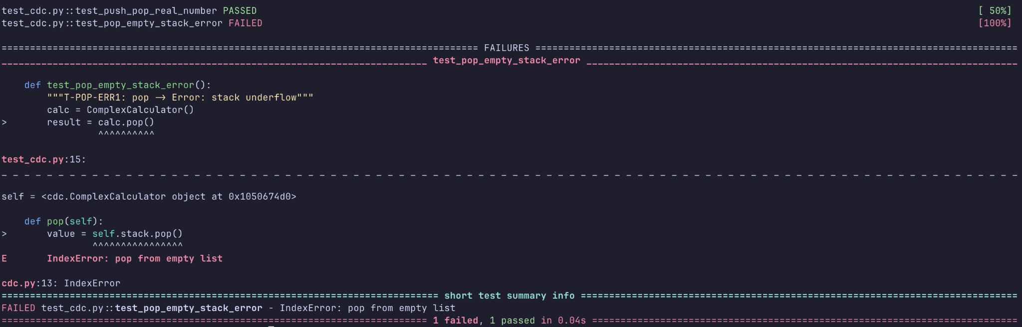
TEST2 FAILURE

Slide 8
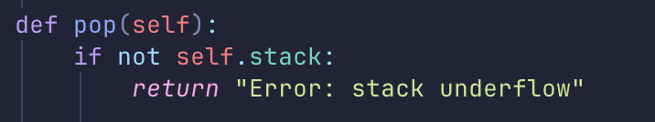
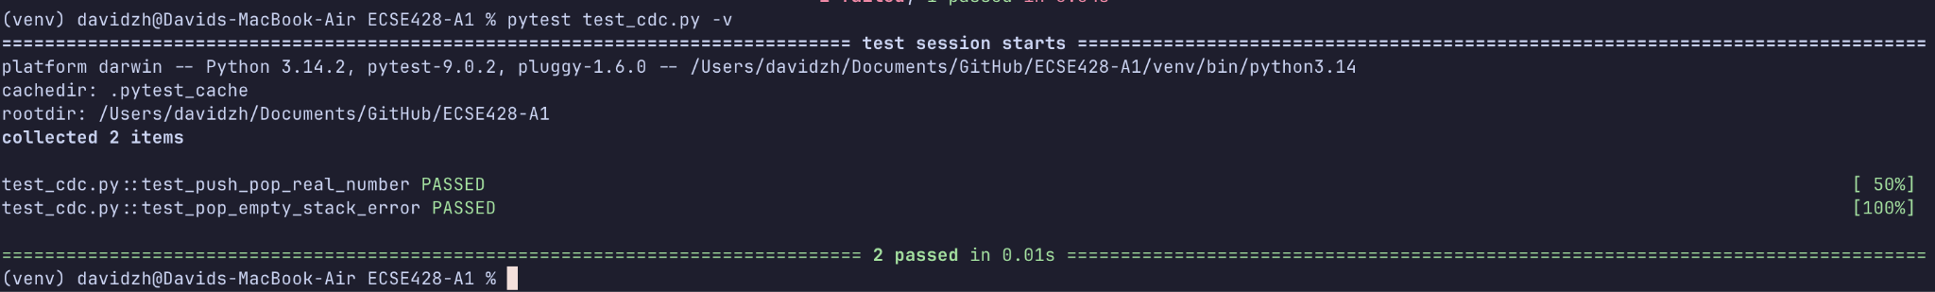
TEST2 SUCCESS

Slide 9
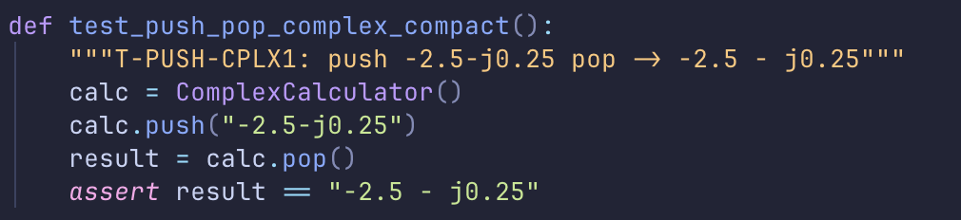
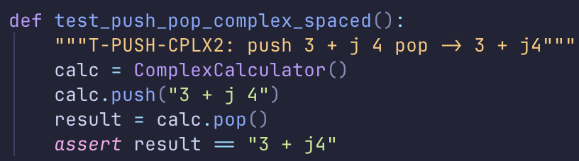
TEST3-4: T-PUSH-CPLX1 / T-PUSH - CPLX2
Test ID: T-PUSH-CPLX / T-PUSH-CPLX2
Operation: PUSH and POP
Command: push -2.5 - j0.25 pop / push 3 + j 4 pop
Expected Output: -2.5 - j0.25 pop / 3 + j4

Slide 10
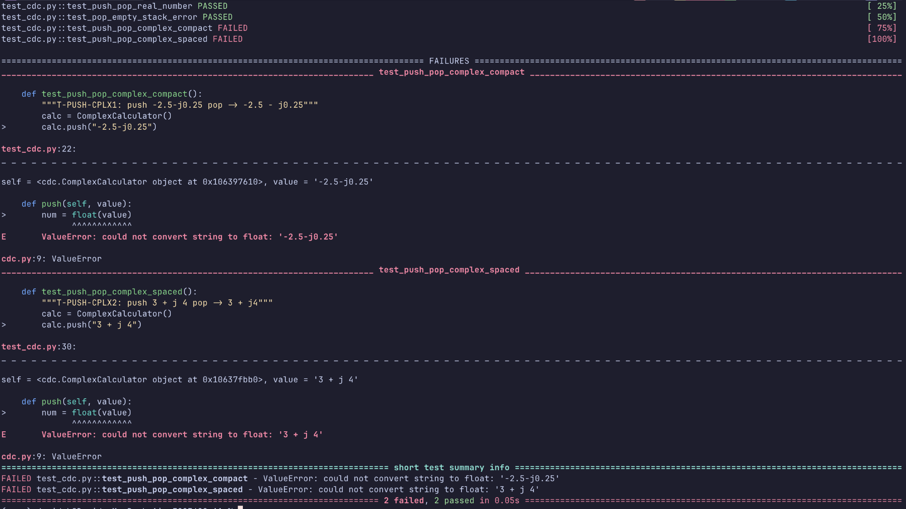
TEST3-4 FAILURE

Slide 11
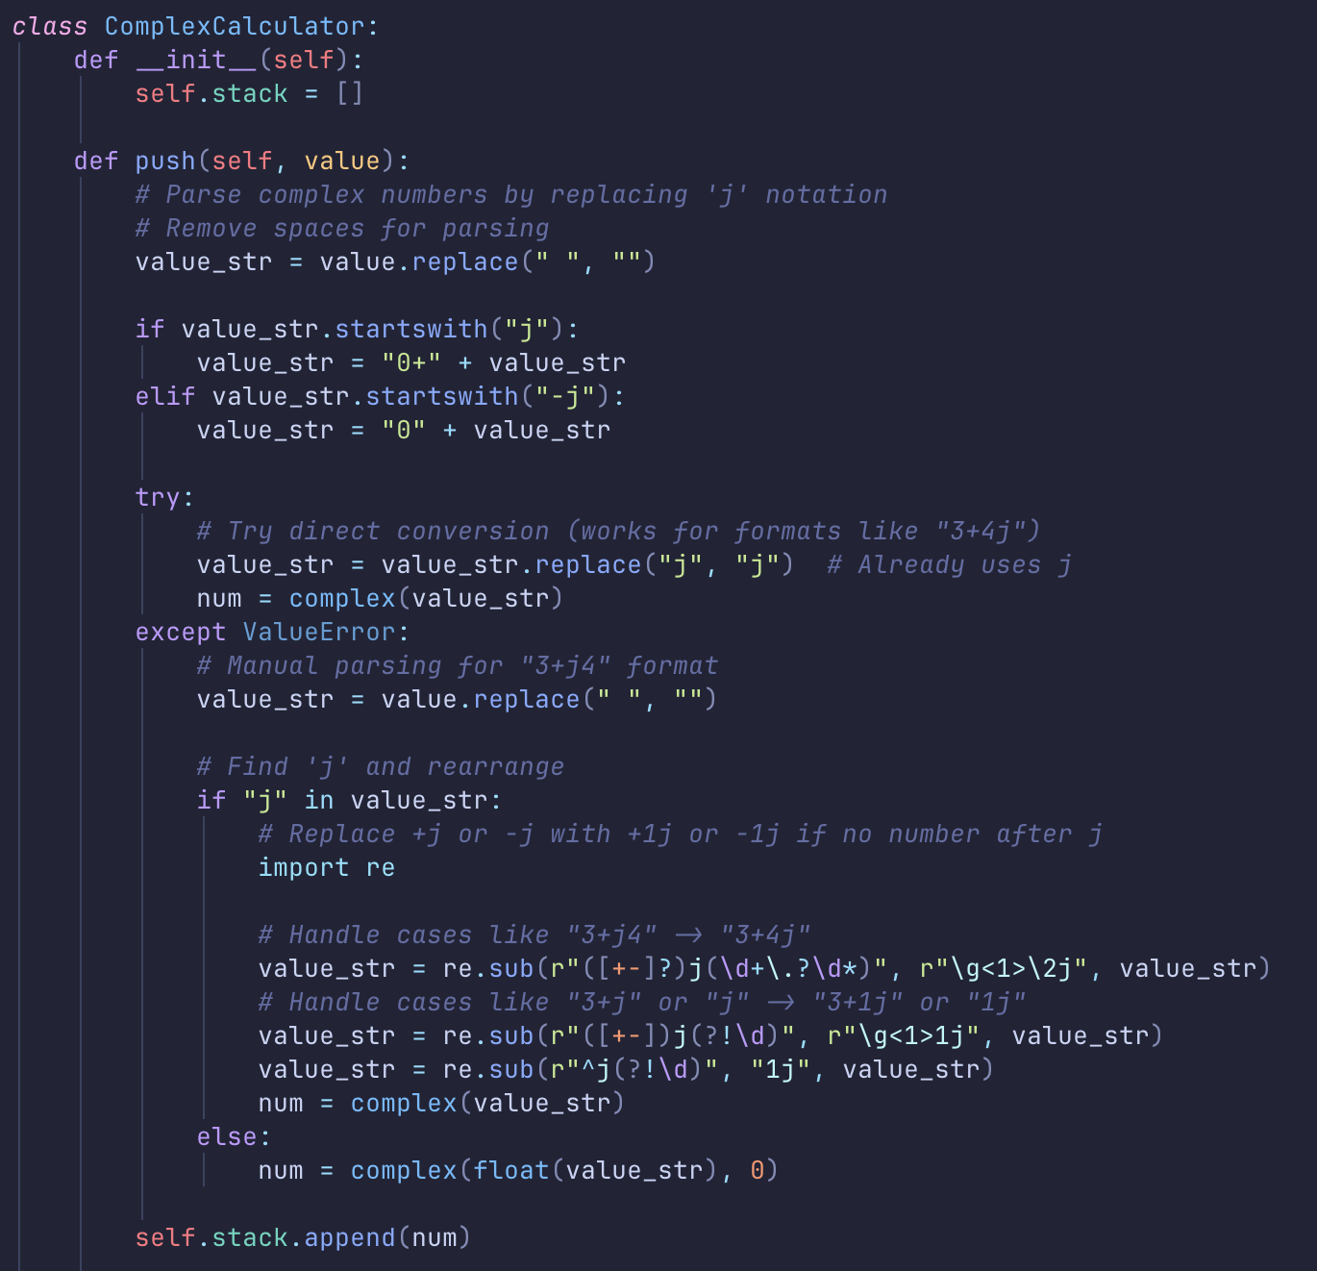
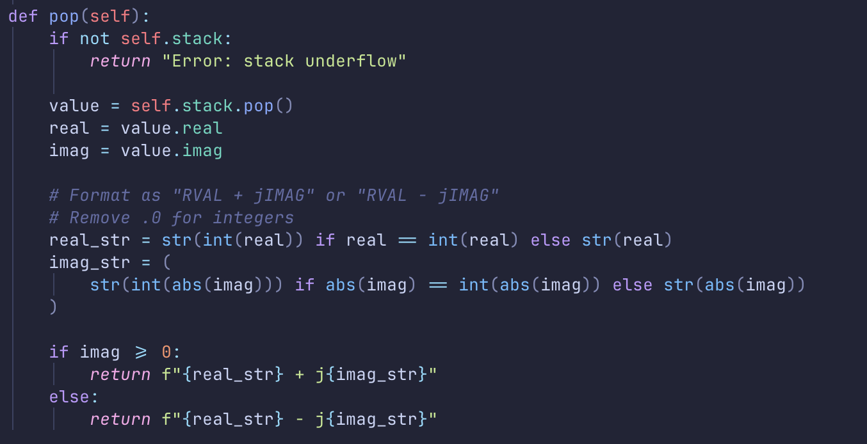
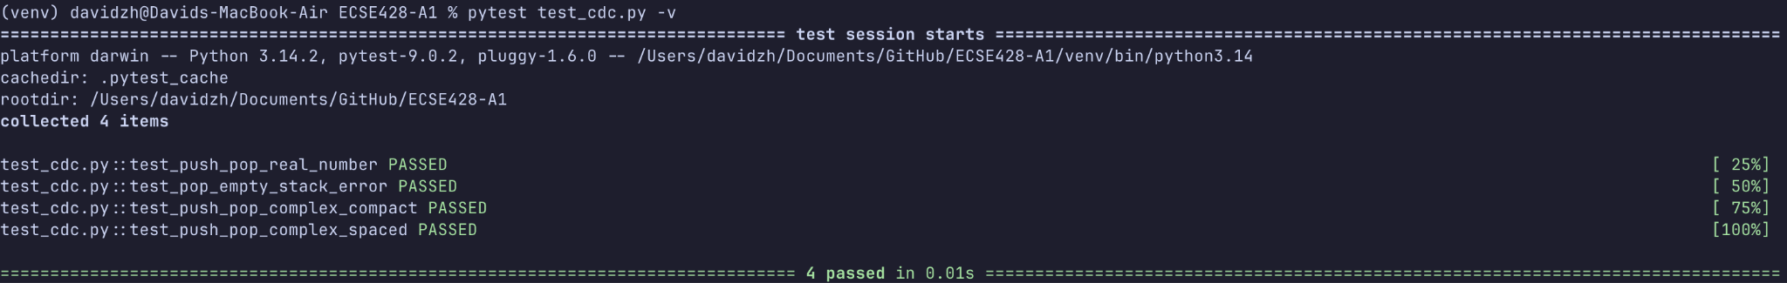
TEST3-4 SUCCESS

Slide 12
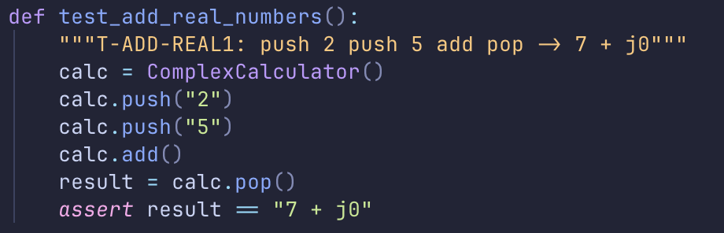
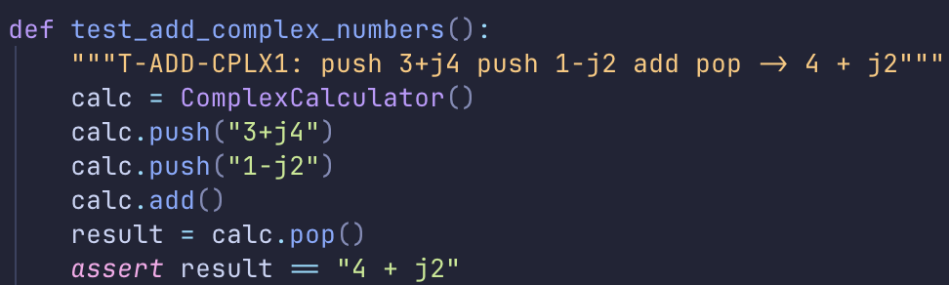
TEST5-6: T-ADD-REAL1 / T-ADD-CPLX1
Test ID: T-PUSH-CPLX2 / T-ADD-CPLX1
Operation: ADD
Command: push 2 push 5 add pop / push 3 + j4 push 1 - j2 add pop
Expected Output: 7 + j0 / 4 + j2

Slide 13
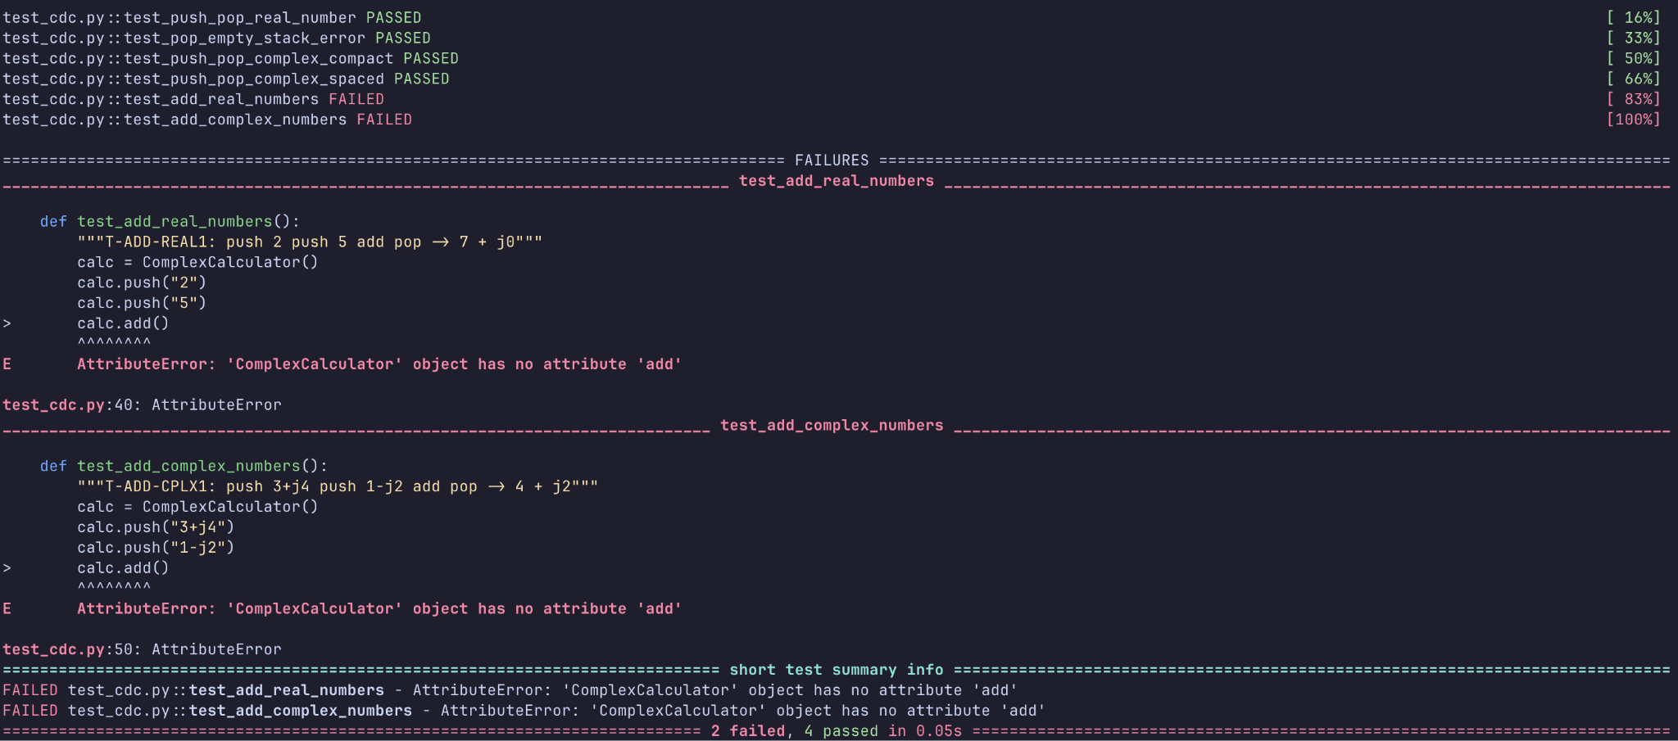
TEST5-6 FAILURE

Slide 14
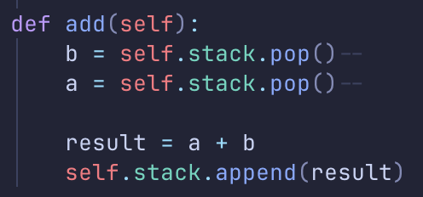
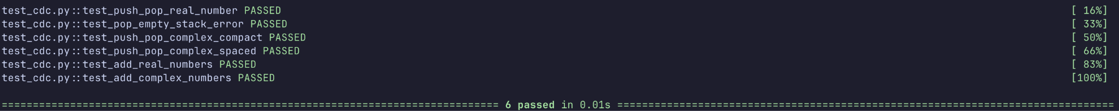
TEST5-6 SUCCESS

Slide 15
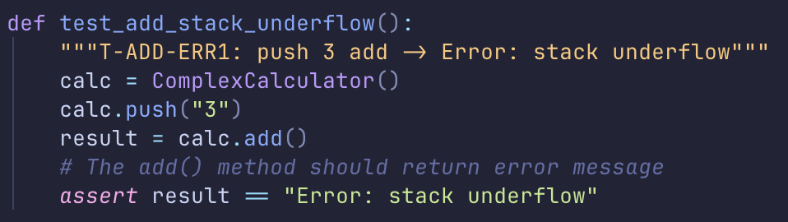
TEST7: T-ADD-ERR1
Test ID: T-ADD-ERR1
Operation: ADD
Command: push 3 add
Expected Output: Error: Stack Underflow

Slide 16
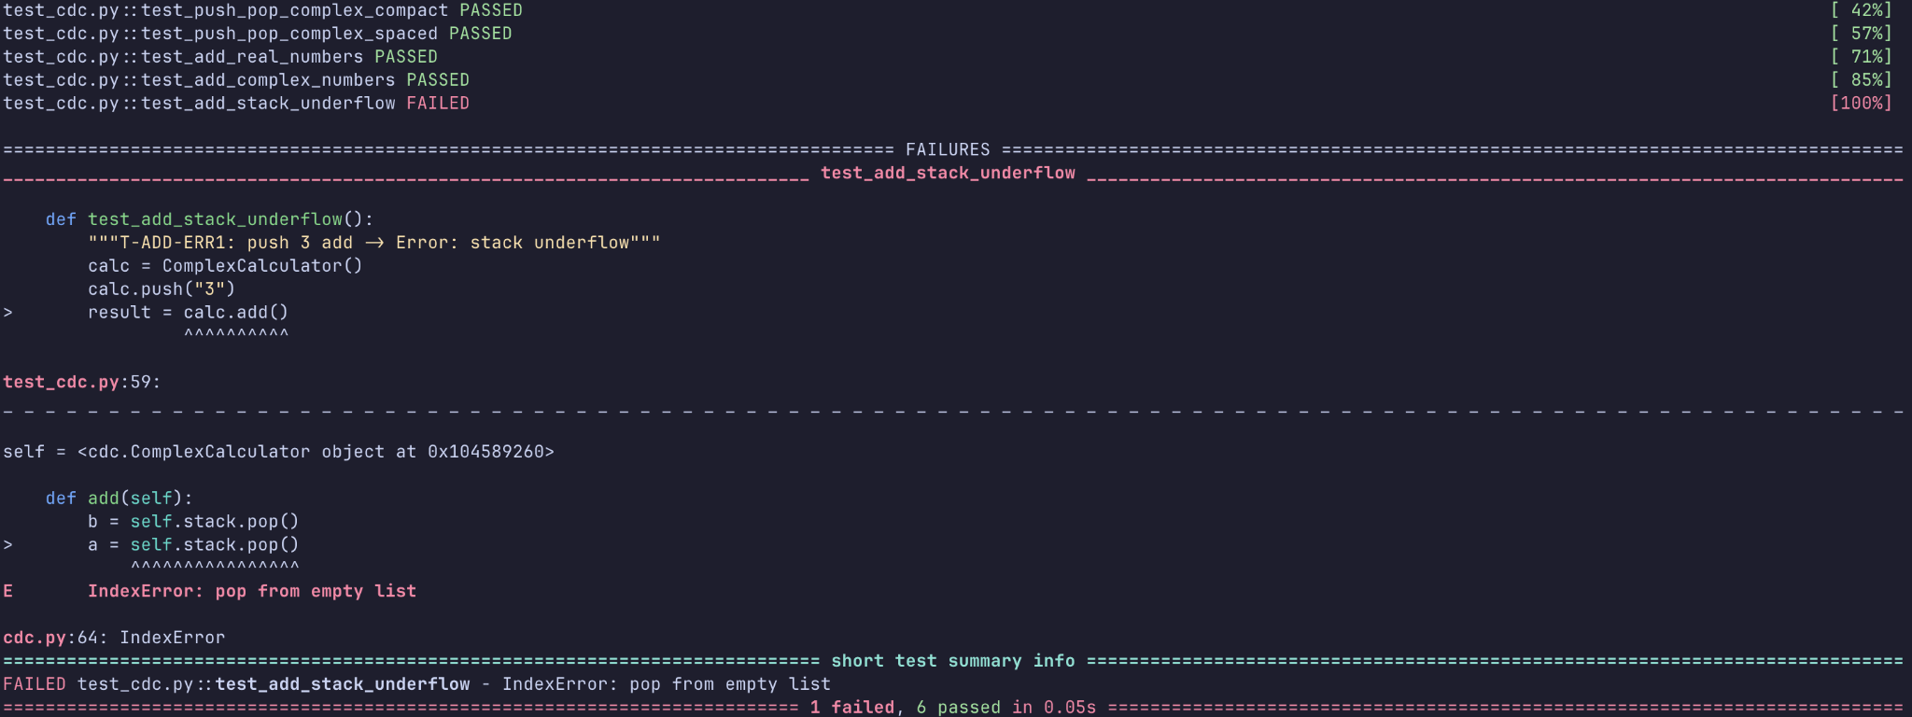
TEST7 FAILURE

Slide 17
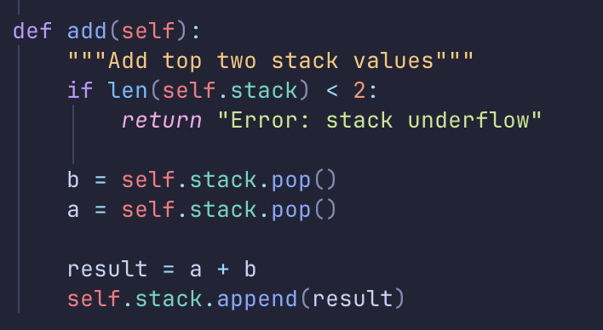
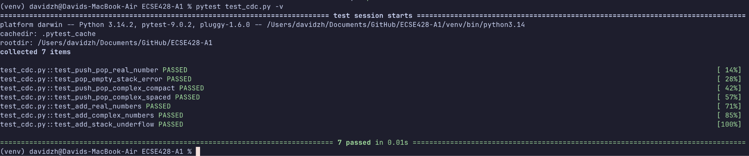
TEST7 SUCCESS

Slide 18
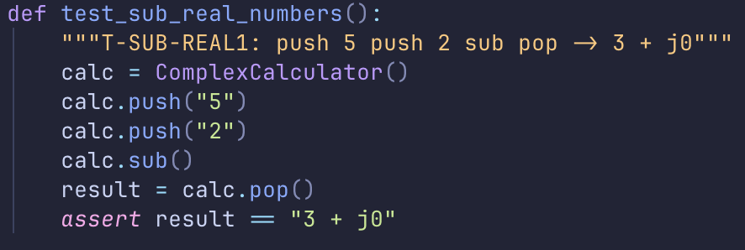
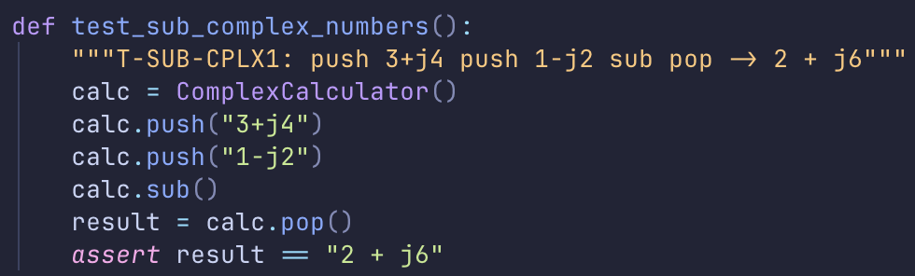
TEST8-9: T-SUB-REAL1 / T-SUB-CPLX1
Test ID: T-SUB-REAL1 / T-SUB-CPLX1
Operation: SUB
Command: push 5 push 2 sub pop / push 3 + j4 push 1 - j2 sub pop
Expected Output: 3 + j0 / 2 + j6

Slide 19
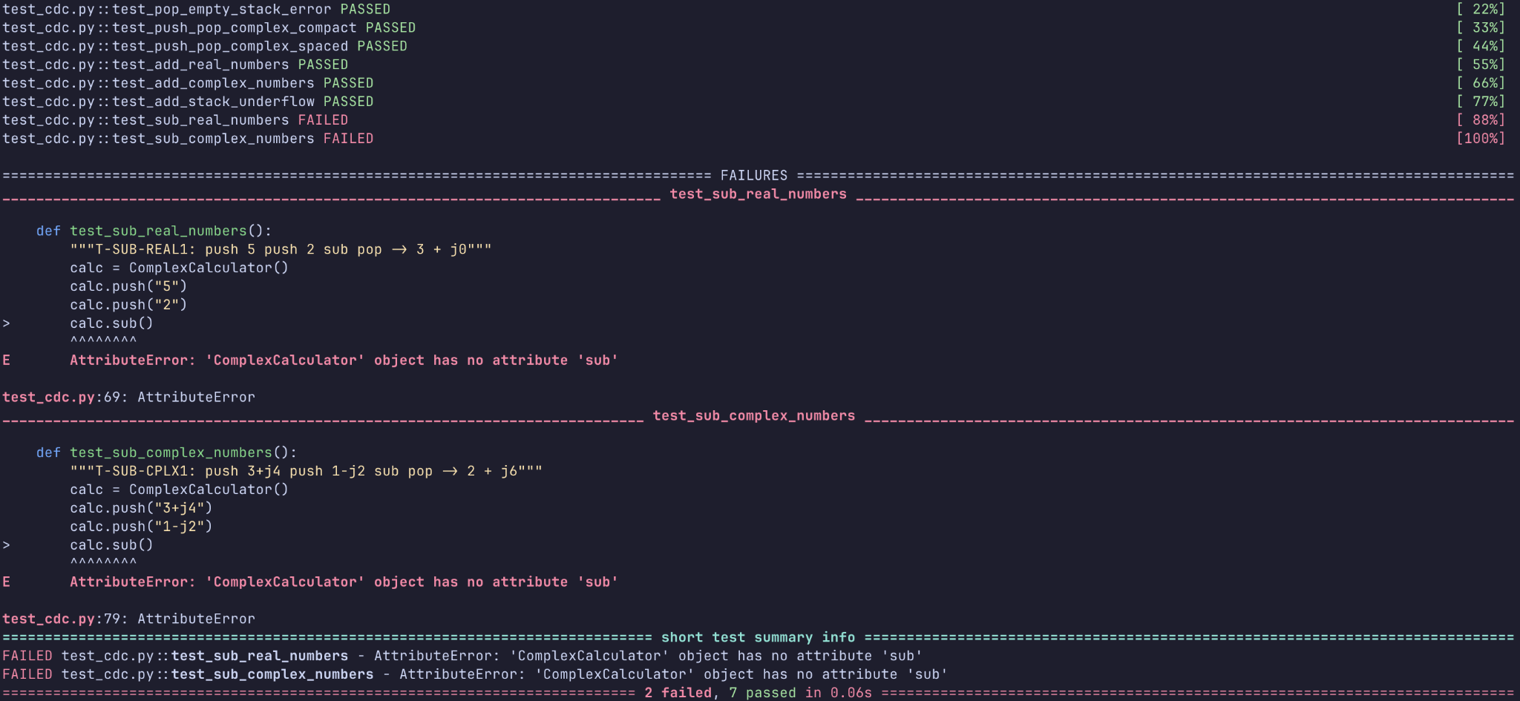
TEST8-9 FAILURE

Slide 20
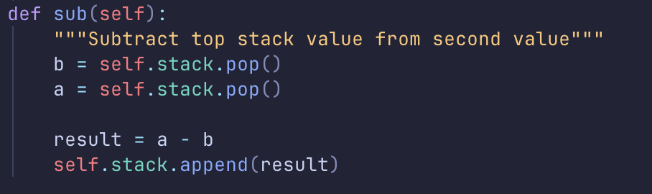
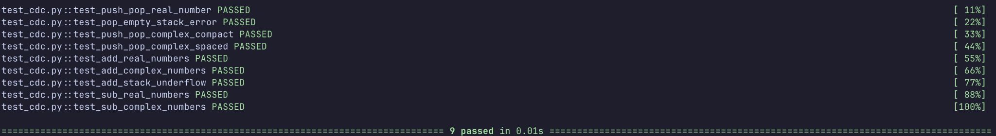
TEST8-9 SUCCESS

Slide 21
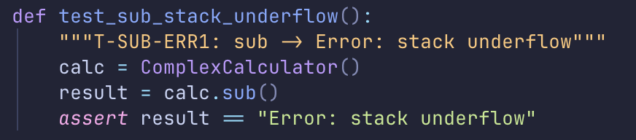
TEST10: T-SUB-ERR1
Test ID: T-SUB-ERR1
Operation: SUB
Command: sub
Expected Output: Error: Stack Underflow

Slide 22
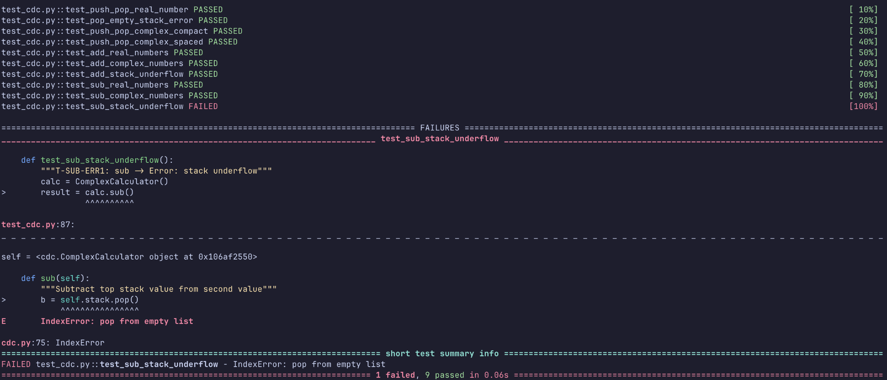
TEST10 FAILURE

Slide 23
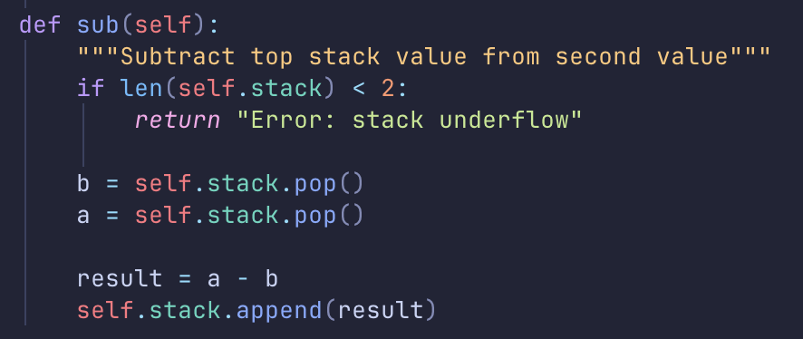
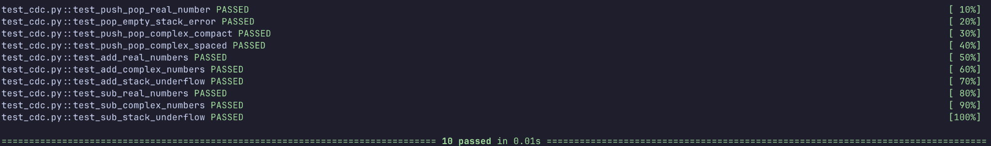
TEST10 SUCCESS

Slide 24
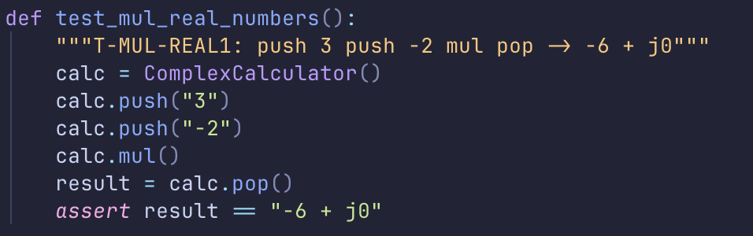
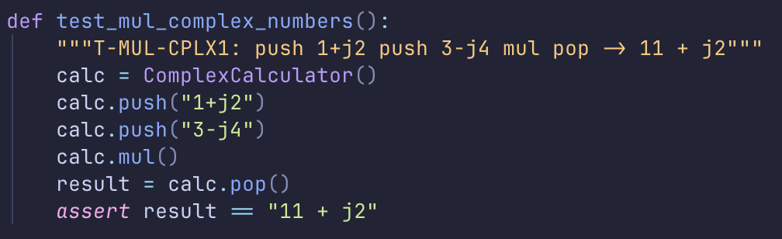
TEST11-12: T-MUL-REAL1 / T-MUL-CPLX1
Test ID: T-MUL-REAL1 / T-MUL-CPLX1
Operation: MUL
Command: push 3 push -2 mul pop / push 1 + j2 push 3 - j4 mul pop
Expected Output: -6 + j0 / 11 + j2

Slide 25
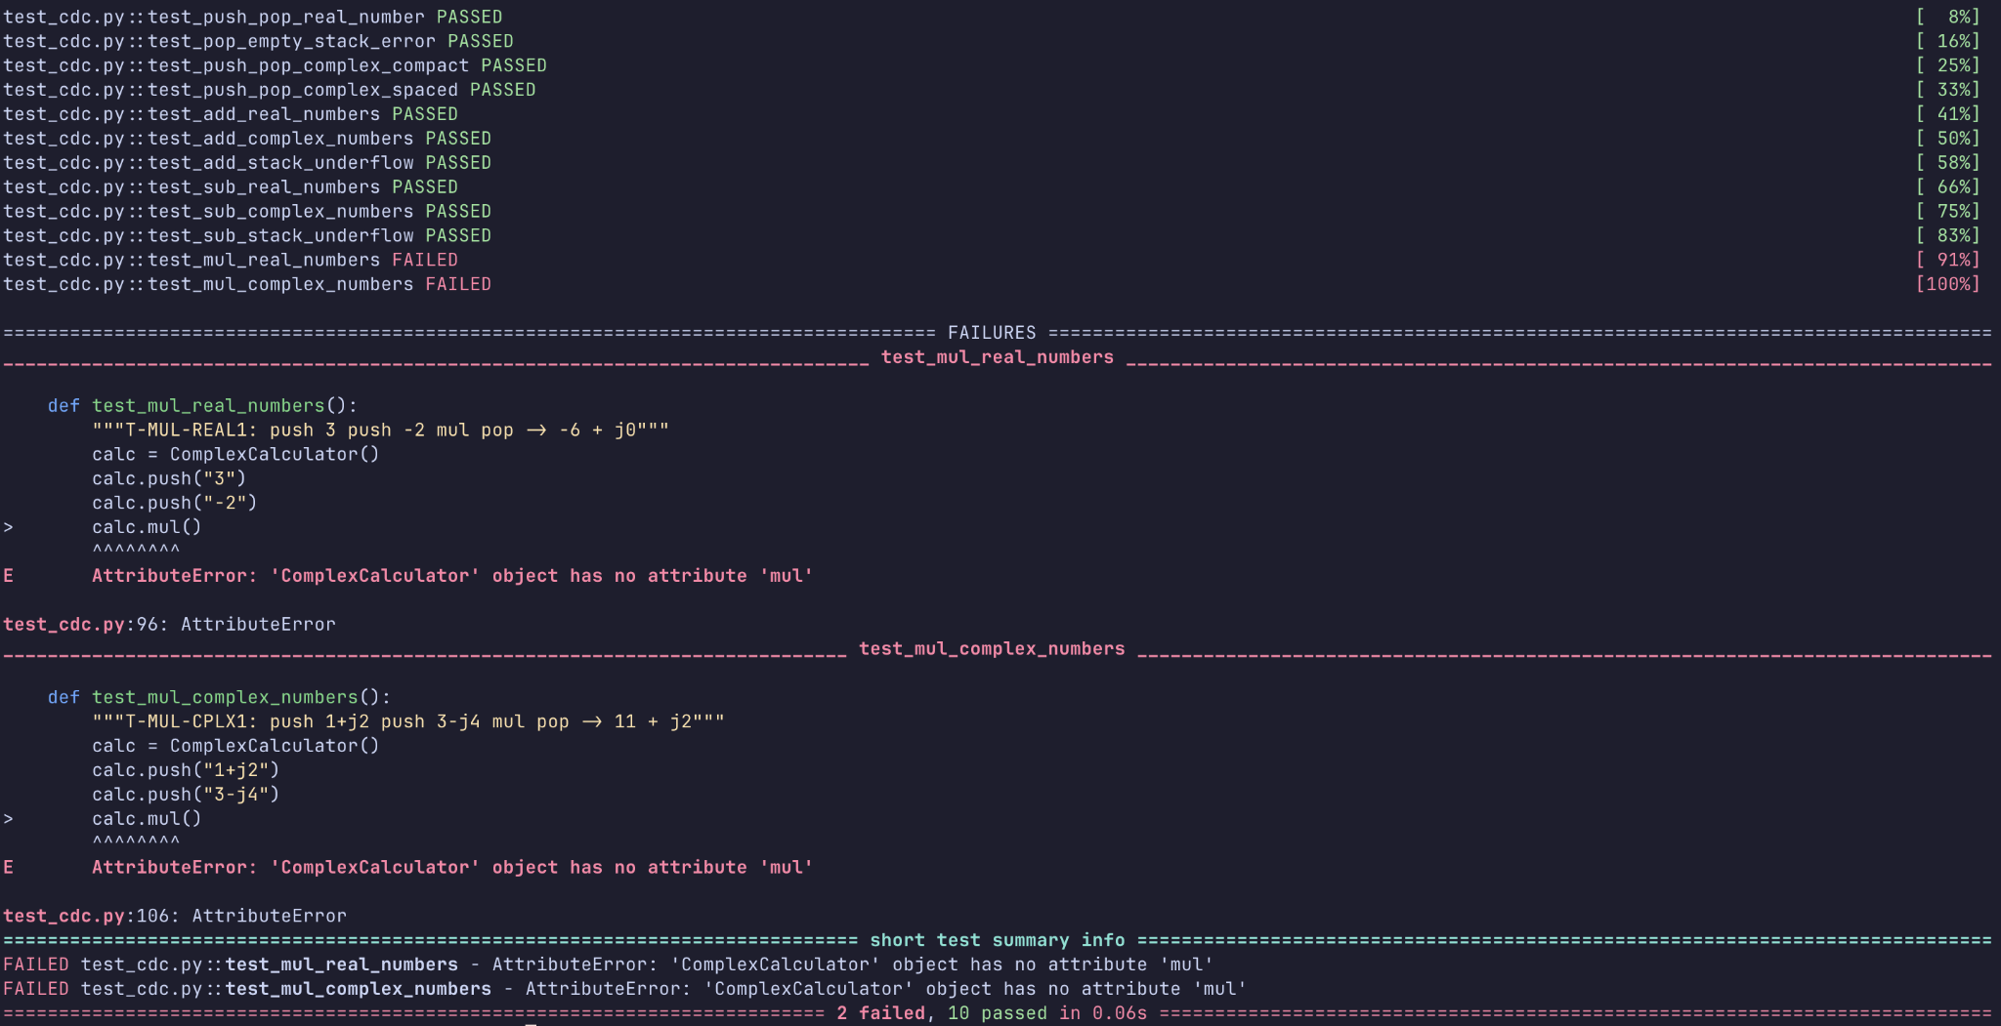
TEST11-12 FAILURE

Slide 26
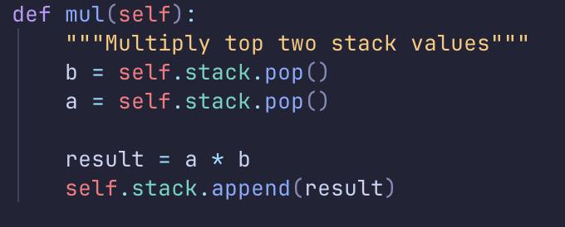
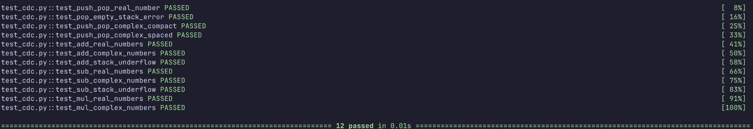
TEST11-12 SUCCESS

Slide 27
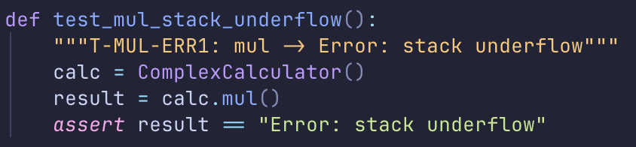
TEST13: T-MUL-ERR1
Test ID: T-MUL-ERR1
Operation: MULT
Command: mul
Expected Output: Error: Stack Underflow

Slide 28
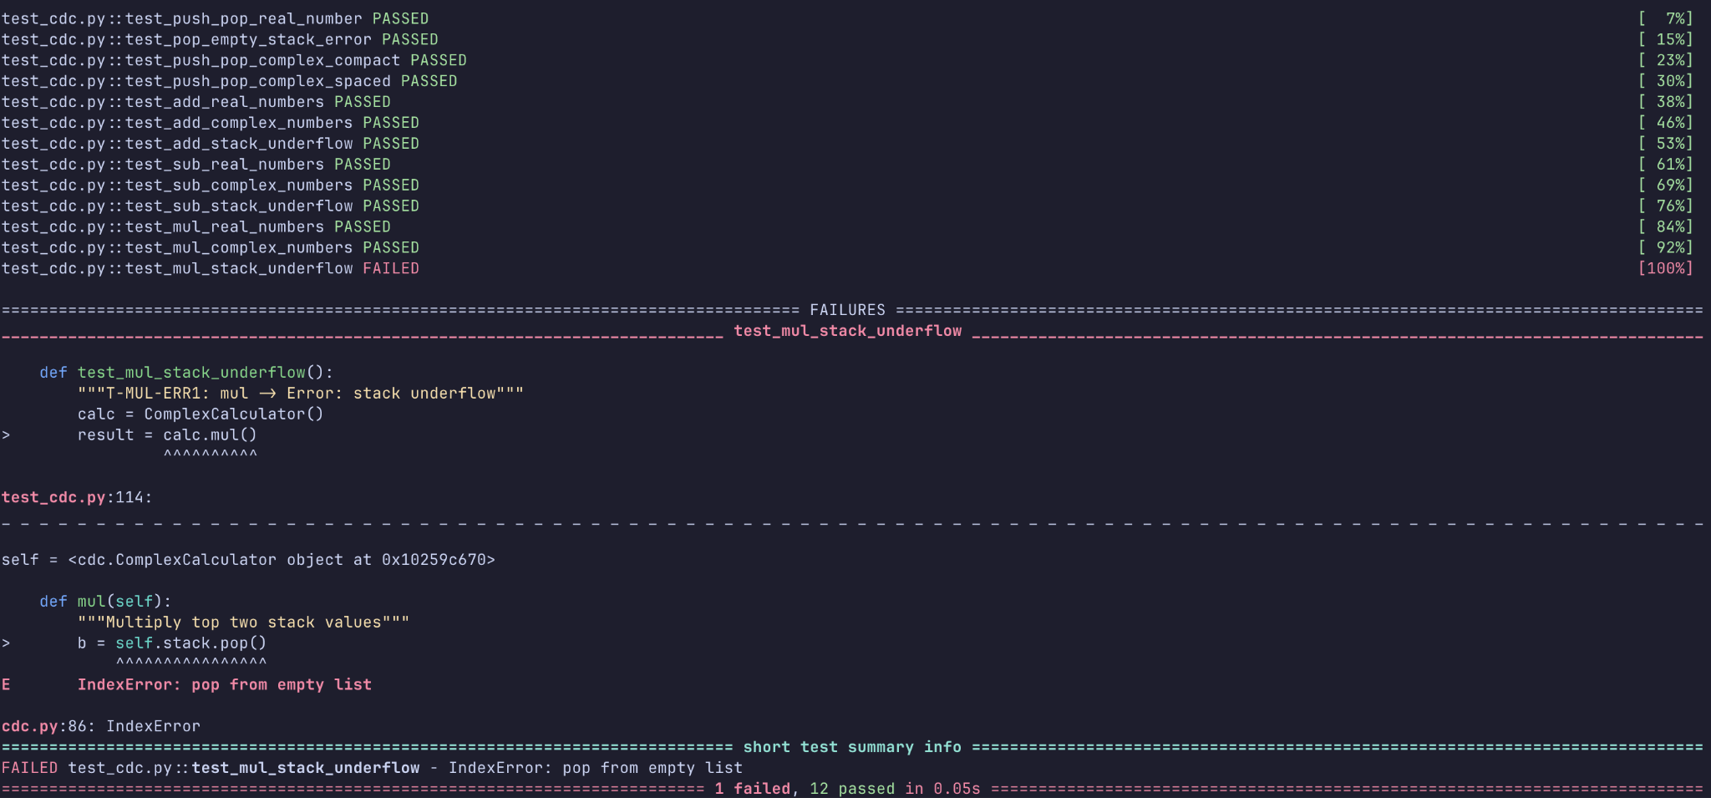
TEST13 FAILURE

Slide 29
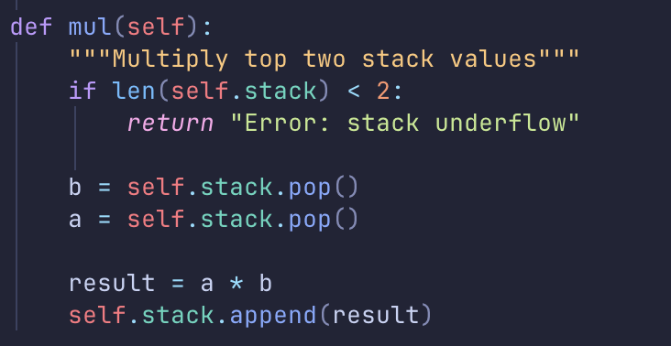
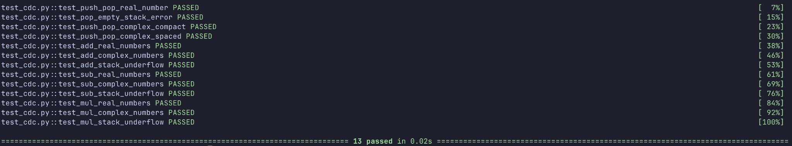
TEST13 SUCCESS

Slide 30
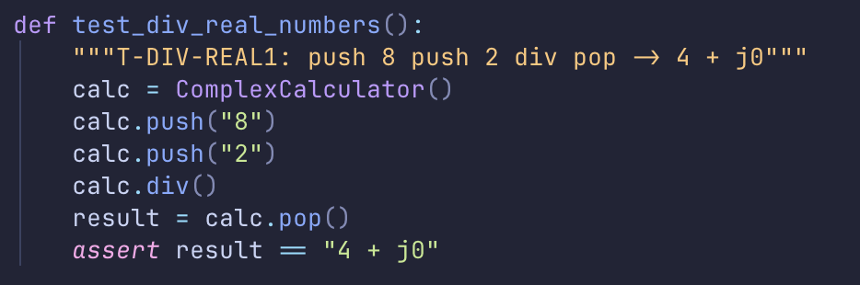
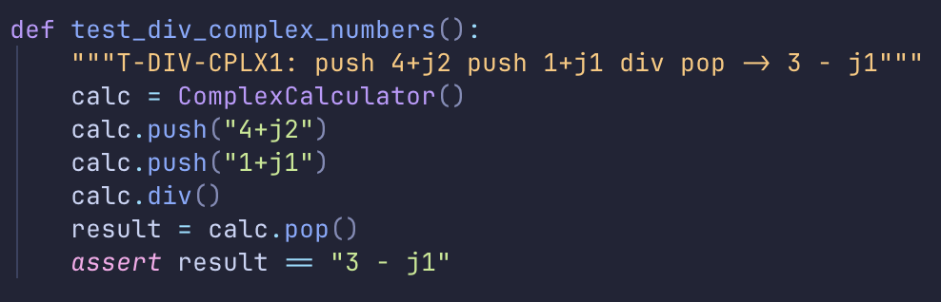
TEST14-15: T-DIV-REAL1 / T-DIV-CPLX1
Test ID: T-DIV-REAL1 / T-DIV-CPLX1
Operation: DIV
Command: push 8 push 2 div pop / push 4 + j2 push 1 + j1 div pop
Expected Output: 4 + j0 / 3 - j1

Slide 31
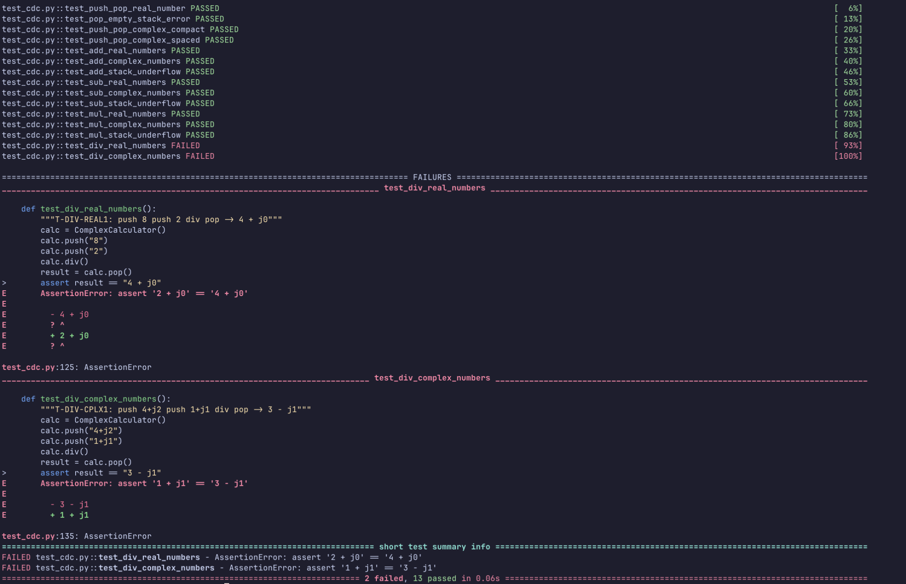
TEST14-15 FAILURE

Slide 32
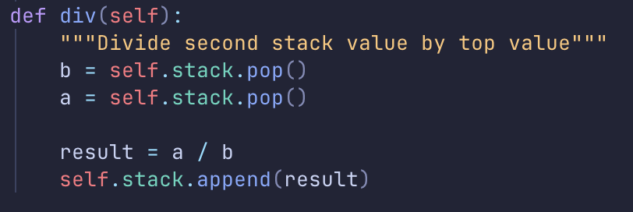
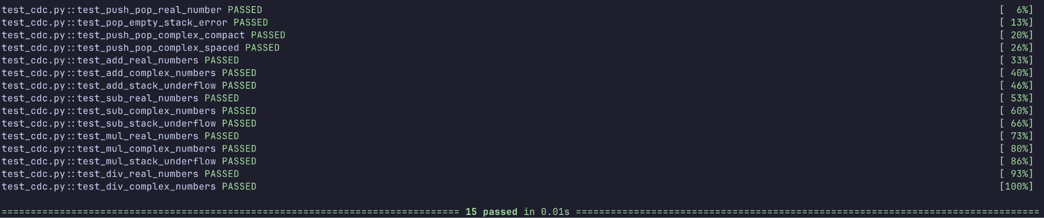
TEST14-15 SUCCESS

Slide 33
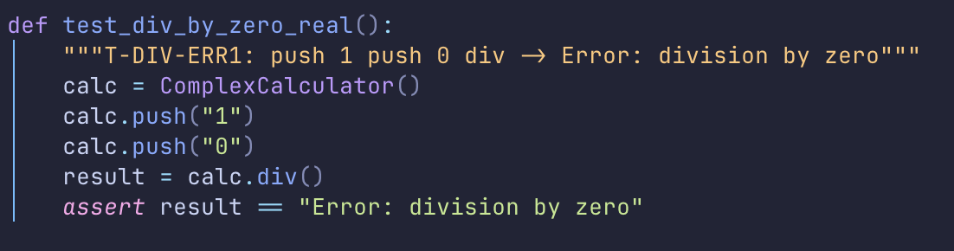
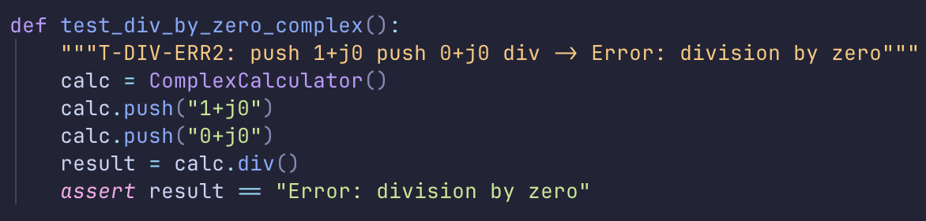
TEST16-17: T-DIV-ERR1 / T-DIV-ERR2
Test ID: T-DIV-ERR1 / T-DIV-ERR2
Operation: DIV
Command: push 1 push 0 div / push 1+j0 push 0+j0 div
Expected Output: Error: Division by 0

Slide 34
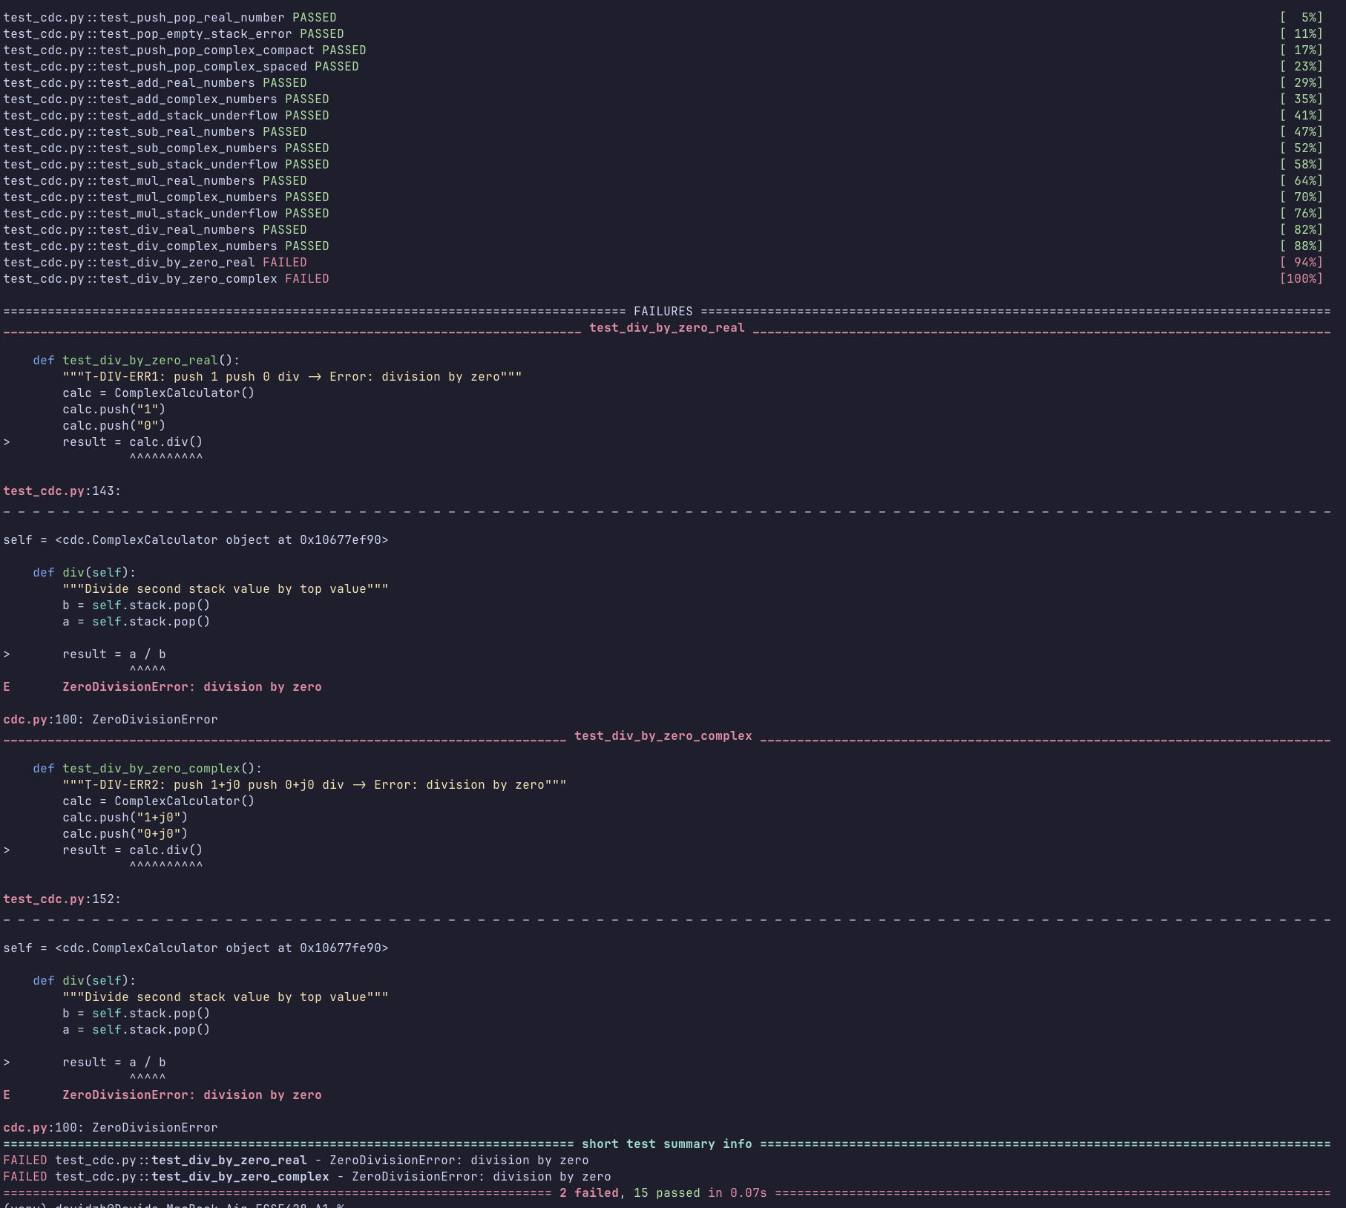
TEST16-17 FAILURE

Slide 35
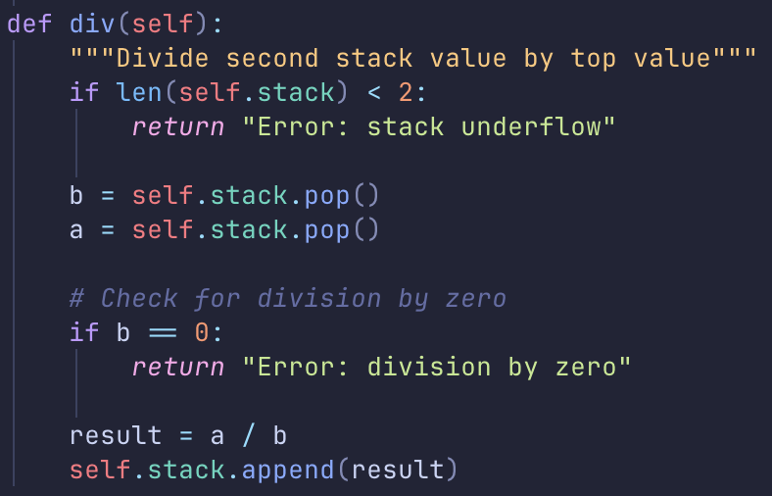

TEST16-17 SUCCESS

Slide 36


TEST18-19: T-DEL-REAL1 / T-DEL-CPLX1
Test ID: T-DEL-REAL1 / T-DEL-CPLX1
Operation: DELETE
Command: push 1 push 2 delete pop / push 1+j1 push 2+j3 delete pop
Expected Output: 1 + j0 / 1 + j1

Slide 37

TEST18-19: FAILURE

Slide 38


TEST18-19 SUCCESS

Slide 39

TEST20: T-DEL-ERR1
Test ID: T-DEL-ERR1
Operation: DELETE
Command: delete
Expected Output: Error: Stack Underflow

Slide 40

TEST20: FAILURE

Slide 41


TEST20 SUCCESS

Slide 42
CLI
Next, we build the CLI so that the Complex DC Calculator can be run through the terminal
Tests
1.Basic push pop
2.Addition
3.Complex operations
4.Error handling

Slide 43




CLI TEST

Slide 44

CLI TEST: FAILURE

Slide 45

TEST CLI SUCCESS

Slide 46


Code Refactoring
Benefits of Refactoring
DRY Principle: Eliminated 5 instances of duplicated stack underflow checking
Single Responsibility: Each helper method has one clear purpose
Maintainability: Changes to error messages or stack operations need only be made once
Readability: Operation methods are now concise and focused on their core logic
Before
After

Slide 47
Use of Generative AI as a Tool
DO’s
DON'Ts
Use AI to generate one test at a time (follows TDD cycle)
Use AI to write minimal code to pass that test
Review all generated code for correctness and scope
Use AI for refactoring only when all tests are green
Document all prompts used alongside the code
Don't generate entire test suites at once
Don't skip the Red-Green-Refactor cycle
Don't blindly trust AI output, verify it works
Don't let AI add features beyond the current requirement

Slide 48
How AI Was Used in This Assignment
RED
GREEN
REFACTOR
Generated single failing test for each operation
Generated minimal code to pass that specific test.
Run full test suite and all previous pass
Suggested helper methods to reduce duplication
Key Principle: AI assists, but we are responsible for understanding and validating all the code.

Slide 49




(1/13) Prompts Used with TDD
Basic Stack Setup and Push/Pop for Real Numbers
Write Test Prompt
Write Code Prompt

Slide 50




(2/13) Prompts Used with TDD
Pop Error Handling
Write Test Prompt
Write Code Prompt

Slide 51




(3/13) Prompts Used with TDD
Complex Number Parsing (Compact Format)
Write Code Prompt
Write Test Prompt

Slide 52




(4/13) Prompts Used with TDD
Complex Number Parsing (Spaced Format)
Write Test Prompt
Write Code Prompt

Slide 53




(5/13) Prompts Used with TDD
ADD Operation (Real Numbers)
Write Test Prompt
Write Code Prompt

Slide 54




(6/13) Prompts Used with TDD
ADD Operation (Complex Numbers)
Write Test Prompt
Write Code Prompt

Slide 55




(7/13) Prompts Used with TDD
ADD Error Handling
Write Test Prompt
Write Code Prompt

Slide 56




(8/13) Prompts Used with TDD
SUB Operation
Write Test Prompt
Write Code Prompt

Slide 57




(9/13) Prompts Used with TDD
MUL Operation
Write Test Prompt
Write Code Prompt

Slide 58




(10/13) Prompts Used with TDD
DIV Operation
Write Test Prompt
Write Code Prompt

Slide 59




(11/13) Prompts Used with TDD
DELETE Operation
Write Test Prompt
Write Code Prompt

Slide 60






(12/13) Prompts Used with TDD
CLI Integration
Write Code Prompt
Write Test Prompt

Slide 61


(13/13) Prompts Used with TDD
Refactoring (After All Tests Pass)
Refactor

Slide 62
THANK YOU!
David Zhou (261135446)
David Vo (261170038)

